Slide 1
Varnost pri šolanju
Osvežitveni seminar za učitelje letenja –FI/A, FI/S, FI/ULN
Januar 2024
Content:
How safe is flying
Statistics 2023
Eng failure after T/O
Midair collision
LOC in flight
Complacency
TEM
Three strikes rule
Other risks

Slide 2
Welcome
Content:
How safe is flying
Statistics 2023
Eng failure after T/O
Midair collision
LOC in flight
Complacency
TEM
Three strikes rule
Other risks
Chance to think about flight safety and our flying
Opportunity to learn from others and share insights
Honest conversation – no preaching!
Adopt - Adapt - Discard

Slide 3
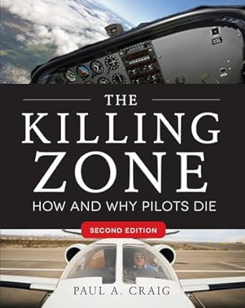
How safe is flying
Content:
How safe is flying
Statistics 2023
Eng failure after T/O
Midair collision
LOC in flight
Complacency
TEM
Three strikes rule
Other risks

Slide 4
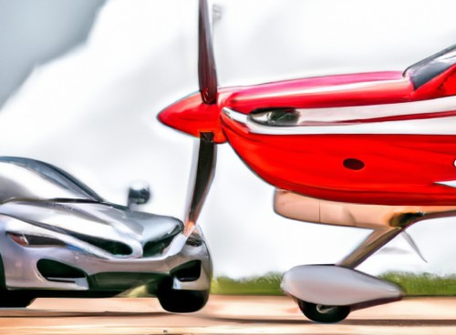
How safe is flying
Flying vs. Driving
Driving home is the most dangerous part of flight. Correct?
Statistics 2000-2009:
GA: 2.32 deaths / 100,000 h flown = 15.4 / million miles flown (at 150 mph)
Airline: 0.65 deaths / million miles flown
Roads: 1.41 deaths per million miles driven
Content:
How safe is flying
Statistics 2023
Eng failure after T/O
Midair collision
LOC in flight
Complacency
TEM
Three strikes rule
Other risks

Slide 5
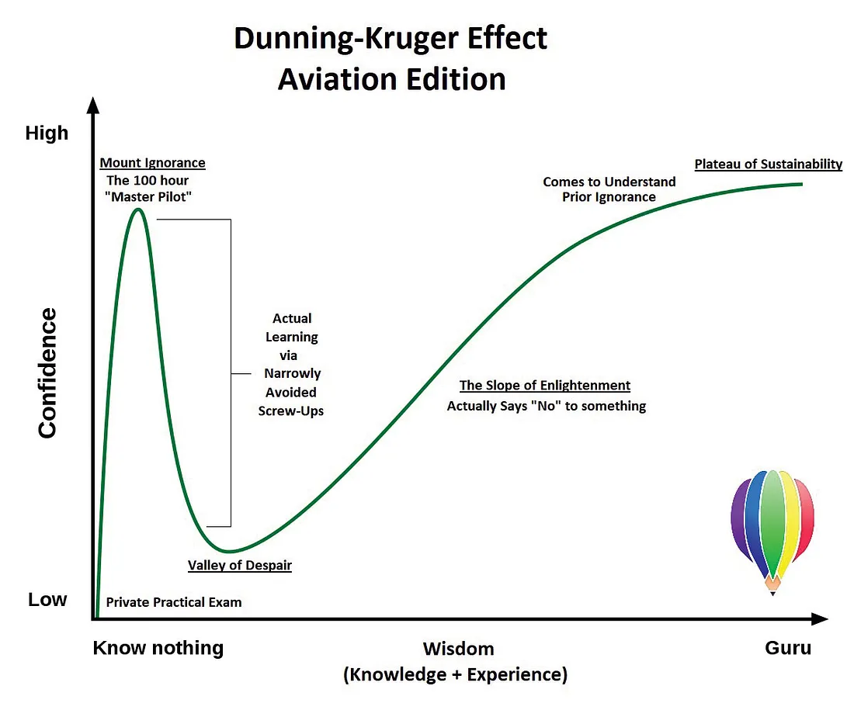
How safe is flying
General aviation vs. Airline flying
More takeoffs and landings per flight
Higher variety of airports (shorter, narrower, worse equipt)
Nature of operation: crop dusting, SAR, cloud seeding, parachute drop…
Inexperience (although it includes professionals)
Content:
How safe is flying
Statistics 2023
Eng failure after T/O
Midair collision
LOC in flight
Complacency
TEM
Three strikes rule
Other risks
Image: https://medium.com/faa/rise-to-the-top-aae3c611ca48

Slide 6
2023 – Training accidents & fatalities - Airplanes
Content:
How safe is flying
Statistics 2023
Eng failure after T/O
Midair collision
LOC in flight
Complacency
TEM
Three strikes rule
Other risks
Source: https://aviation-safety.net/wikibase/

Slide 7
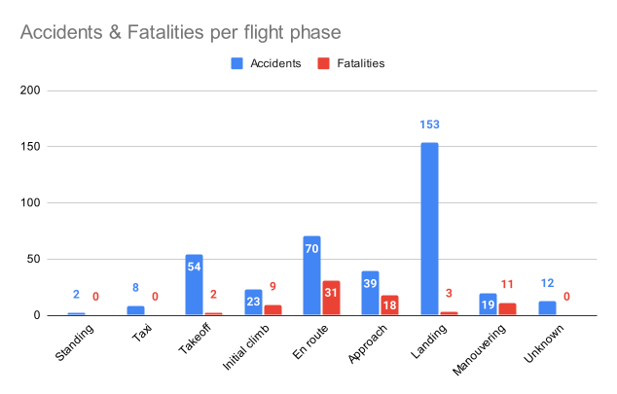
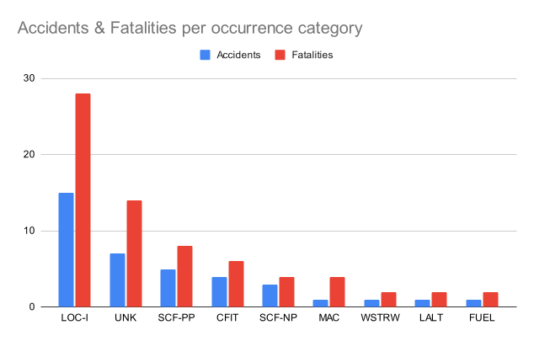
2023 – Training accidents & fatalities - Airplanes
Content:
How safe is flying
Statistics 2023
Eng failure after T/O
Midair collision
LOC in flight
Complacency
TEM
Three strikes rule
Other risks
Source: https://aviation-safety.net/wikibase/

Slide 8
2023 – Training accidents & fatalities - Sailplanes
Content:
How safe is flying
Statistics 2023
Eng failure after T/O
Midair collision
LOC in flight
Complacency
TEM
Three strikes rule
Other risks
Source: https://aviation-safety.net/wikibase/

Slide 9
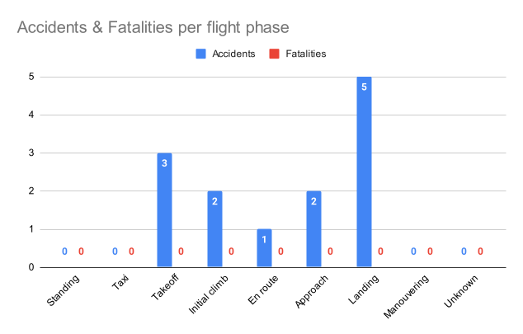
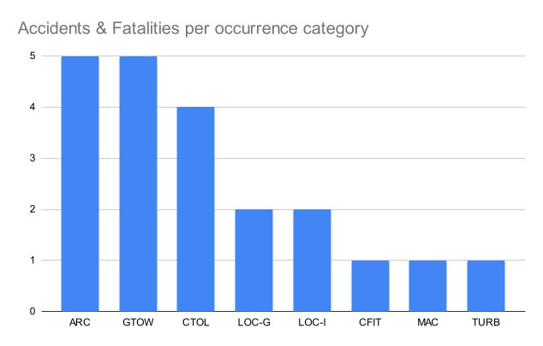
2023 – Training accidents & fatalities - Sailplanes
Content:
How safe is flying
Statistics 2023
Eng failure after T/O
Midair collision
LOC in flight
Complacency
TEM
Three strikes rule
Other risks
Source: https://aviation-safety.net/wikibase/

Slide 10
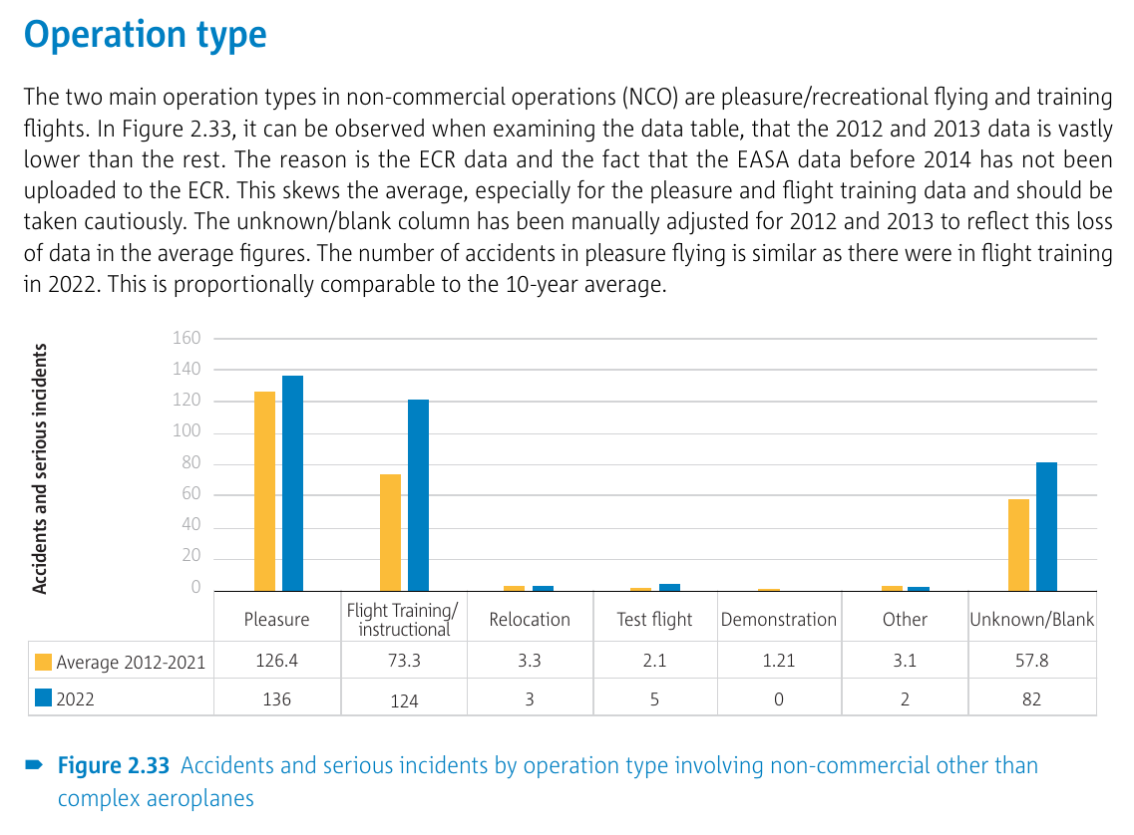
2023 – Non-commercial other than complex aeroplanes
Content:
How safe is flying
Statistics 2023
Eng failure after T/O
Midair collision
LOC in flight
Complacency
TEM
Three strikes rule
Other risks
Source:
Source: 2023 Annual Safety Review, EASA, Catalogue number TO-AA-23-001-EN-N, ISBN 978-92-9210-281-4

Slide 11
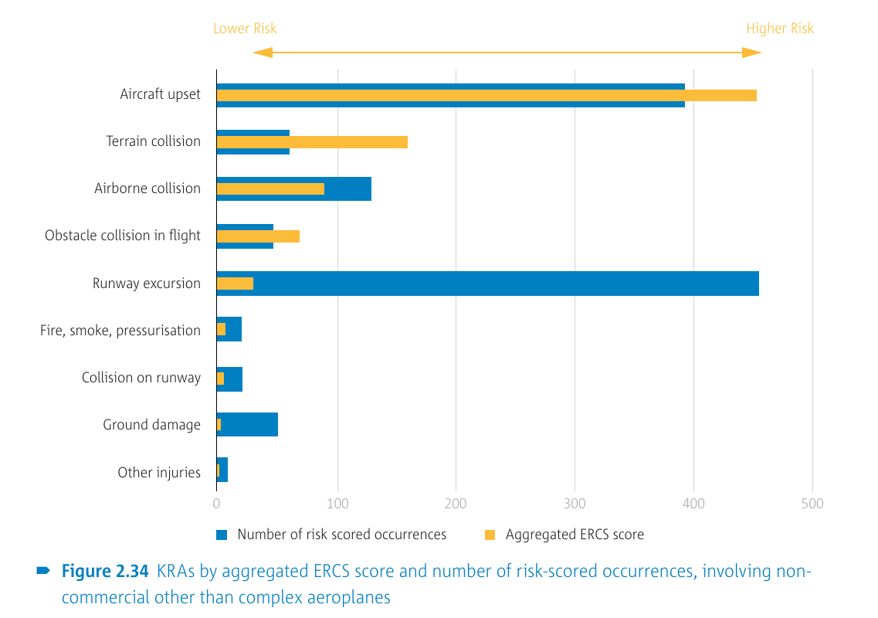
2023 – Non-commercial other than complex aeroplanes
Content:
How safe is flying
Statistics 2023
Eng failure after T/O
Midair collision
LOC in flight
Complacency
TEM
Three strikes rule
Other risks
Source: 2023 Annual Safety Review, EASA, Catalogue number TO-AA-23-001-EN-N, ISBN 978-92-9210-281-4

Slide 12
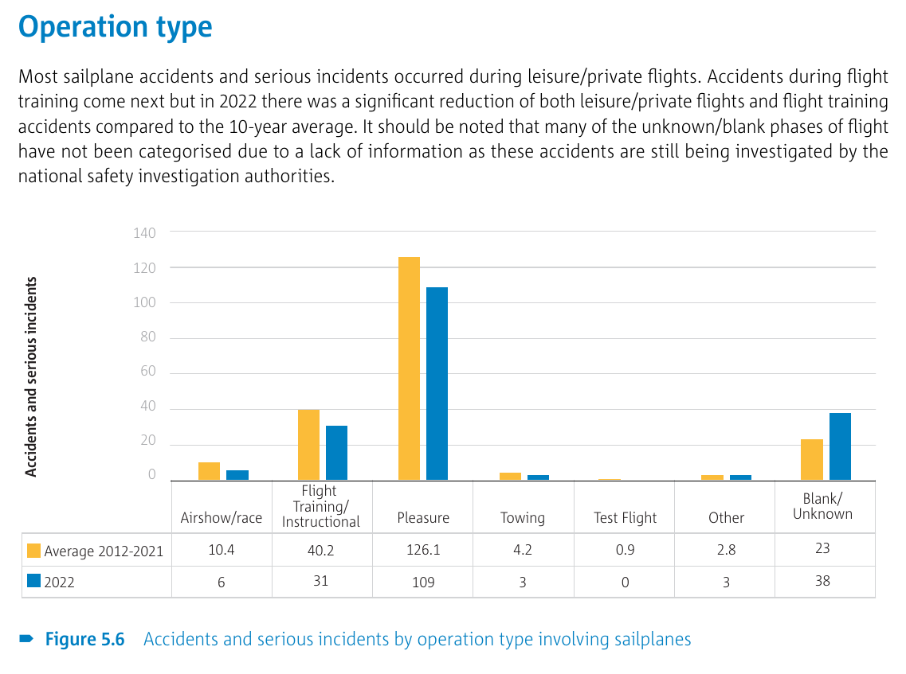
2023 – Sailplanes
Content:
How safe is flying
Statistics 2023
Eng failure after T/O
Midair collision
LOC in flight
Complacency
TEM
Three strikes rule
Other risks
Source: 2023 Annual Safety Review, EASA, Catalogue number TO-AA-23-001-EN-N, ISBN 978-92-9210-281-4

Slide 13
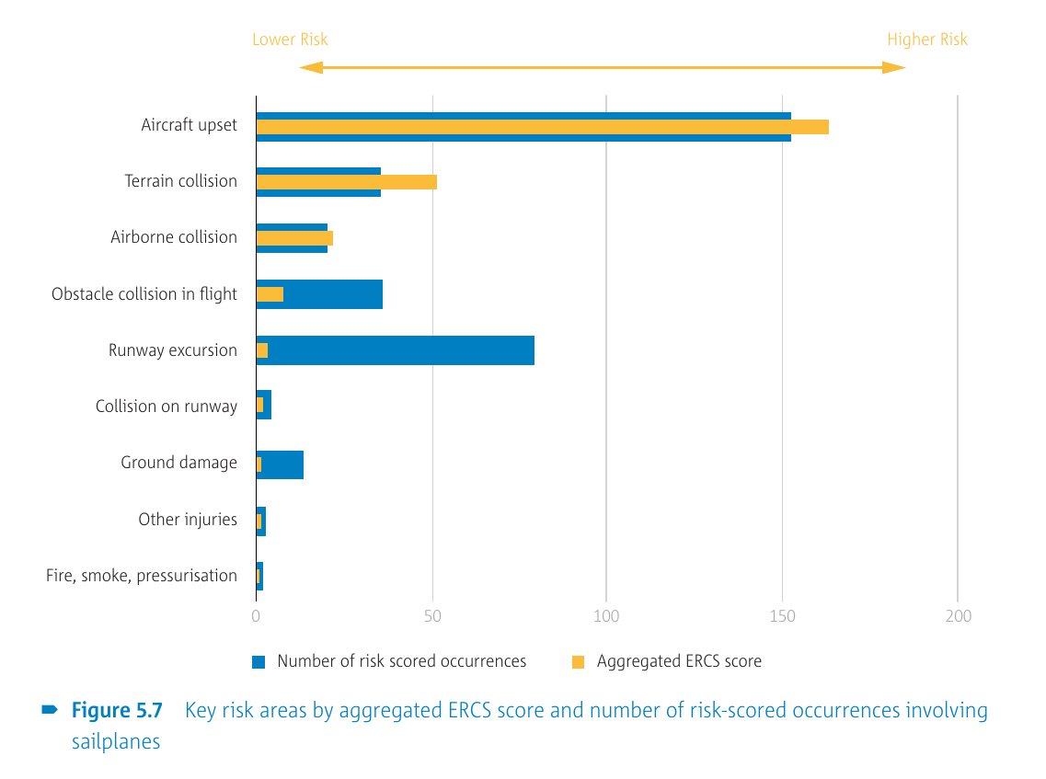
2023 – Sailplanes
Content:
How safe is flying
Statistics 2023
Eng failure after T/O
Midair collision
LOC in flight
Complacency
TEM
Three strikes rule
Other risks
Source: 2023 Annual Safety Review, EASA, Catalogue number TO-AA-23-001-EN-N, ISBN 978-92-9210-281-4

Slide 14
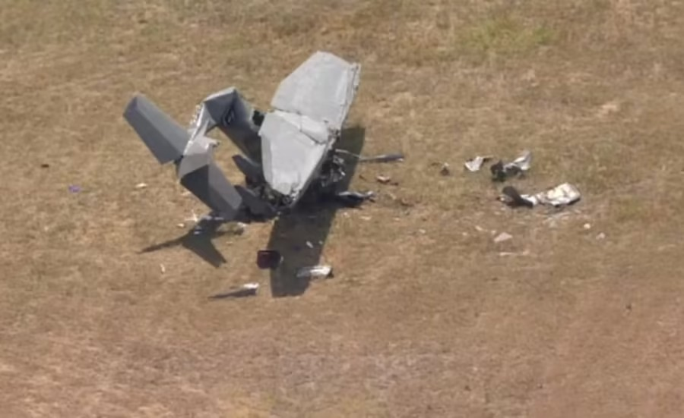
Engine failure after takeoff
Wednesday 6 September 2023
KUTS - Huntsville, TX, USA
Cessna 150K
Fatalities: 2 / Occupants: 2
The flight instructor and student
pilot were fatally injured.
Two witnesses reported that the airplane was flying in the airport traffic pattern before the accident. They saw the airplane flying over runway 18, about 500 ft above the ground, rocking its wings in a level pitch attitude. The airplane then entered a left, nose down, turn toward the east. The flight instructor believed that the pilot of the accident airplane was attempting to make a left 180° turn to land on runway 36. He stated that after the airplane turned about 90° it entered a spin and descended to the ground in a nose down pitch attitude.
Content:
How safe is flying
Statistics 2023
Eng failure after T/O
Midair collision
LOC in flight
Complacency
TEM
Three strikes rule
Other risks
Photo: https://www.click2houston.com/news/local/2023/09/06/plane-reportedly-crashes-on-runway-at-huntsville-regional-airport/

Slide 15
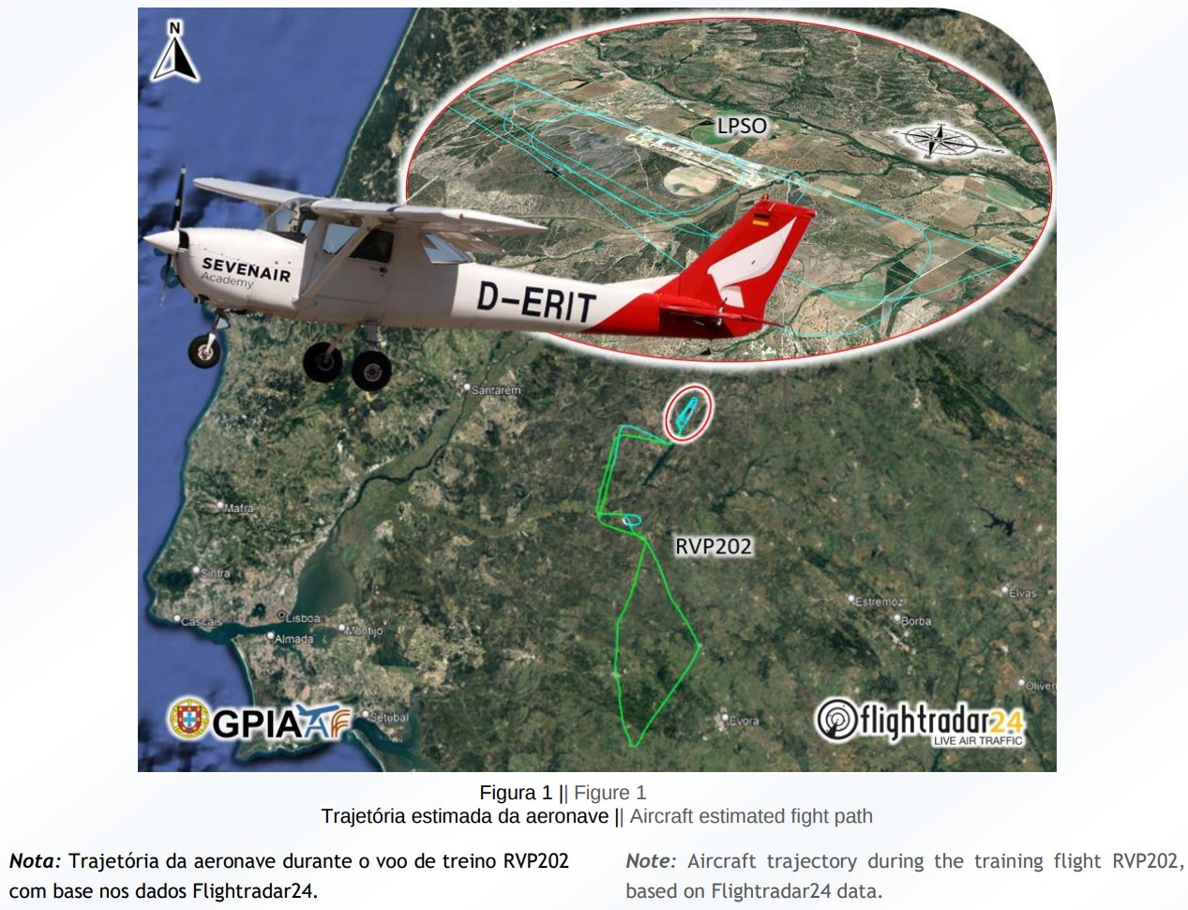
Engine failure after takeoff
Friday 10 November 2023
LPSO - Ponte de Sor Airport - Portugal
Reims-Cessna F150J
Fatalities: 1 / Occupants: 2
The instructor died and student pilot sustained serious injuries.
At 15:45 on runway 21 upwind for what would be the last training circuit, at an estimated altitude of
about 300 ft, the aircraft's engine exhibited malfunctions, recovering immediately to take-off power rotation and, subsequently, it will have lost power altogether.
The aircraft, while overflying the runway 03 threshold area, turned right for brief moments in a westerly direction and then began a 270º turn in an uncontrolled descent.
Content:
How safe is flying
Statistics 2023
Eng failure after T/O
Midair collision
LOC in flight
Complacency
TEM
Three strikes rule
Other risks
Photo: AIRCRAFT ACCIDENT INFORMATION NOTICE, Gabinete de Prevenção e Investição de Acidentes com Aeronaves e de Acidentes Ferroviários

Slide 16
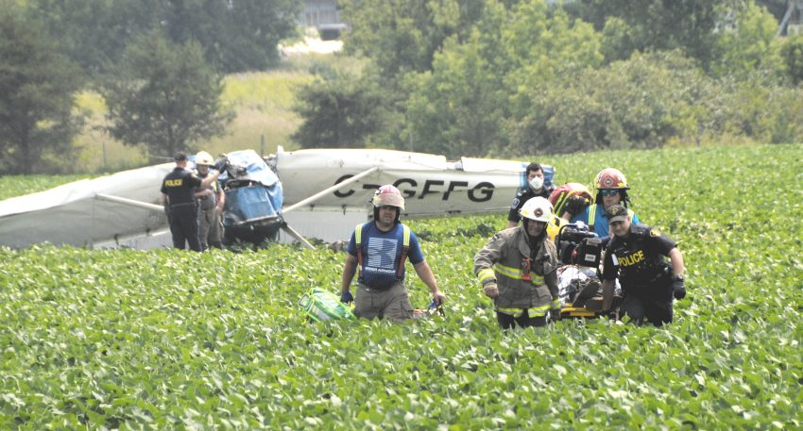
Engine failure after takeoff
Wednesday 26 July 2023
Alexandria Aerodrome, ON - Canada
Cessna 150B
Fatalities: 1 / Occupants: 2
The aircraft was destroyed, one person
was fatally injured, and one received
serious injuries.
Shortly after taking off from Runway 25, the aircraft experienced a partial engine power loss. A 180-degree return was accomplished, and the aircraft was repositioned over runway 07, but significantly down the runway.
Engine power was re-applied, and the aircraft began to climb again. Shortly afterwards, the engine power decreased more considerably; the aircraft entered a steep right bank, followed by a steep nose down attitude and impact with terrain.
Content:
How safe is flying
Statistics 2023
Eng failure after T/O
Midair collision
LOC in flight
Complacency
TEM
Three strikes rule
Other risks
Photo: AIRCRAFT ACCIDENT INFORMATION NOTICE, Gabinete de Prevenção e Investição de Acidentes com Aeronaves e de Acidentes Ferroviários

Slide 17
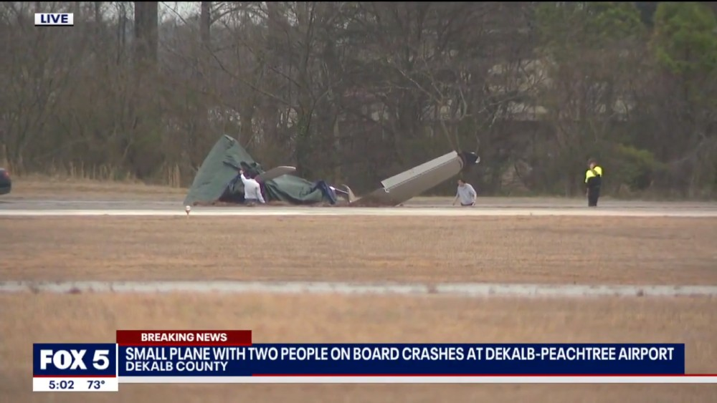
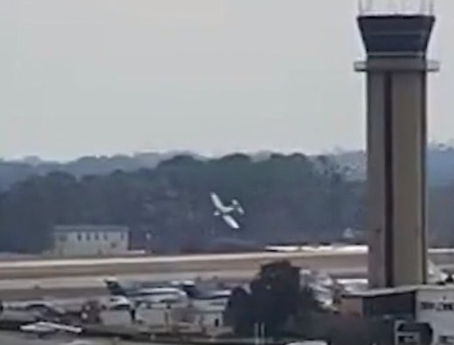
Engine failure after takeoff
Thursday 16 February 2023
KPDK, DeKalb-Peachtree, GA - USA
Piper PA-28-181 Archer II
Fatalities: 0 / Occupants: 2
The flight instructor sustained serious
injuries and the student pilot sustained
minor injuries.
At about 1,100 ft msl (about 100 ft agl), the engine “sputtered” and then lost total power. The instructor immediately reduced the angle of attack and scanned the area ahead and to the right for an emergency landing site. Seeing no safe options, he initiated an immediate and steep bank to the left and pitched the controls forward towards a large grass field. The airplane impacted the ground on the right side of runway 3R. The left wing was separated from the airplane.
Source: https://www.fox5atlanta.com/news/small-plane-crash-lands-at-dekalb-peachtree-airport
Content:
How safe is flying
Statistics 2023
Eng failure after T/O
Midair collision
LOC in flight
Complacency
TEM
Three strikes rule
Other risks

Slide 18
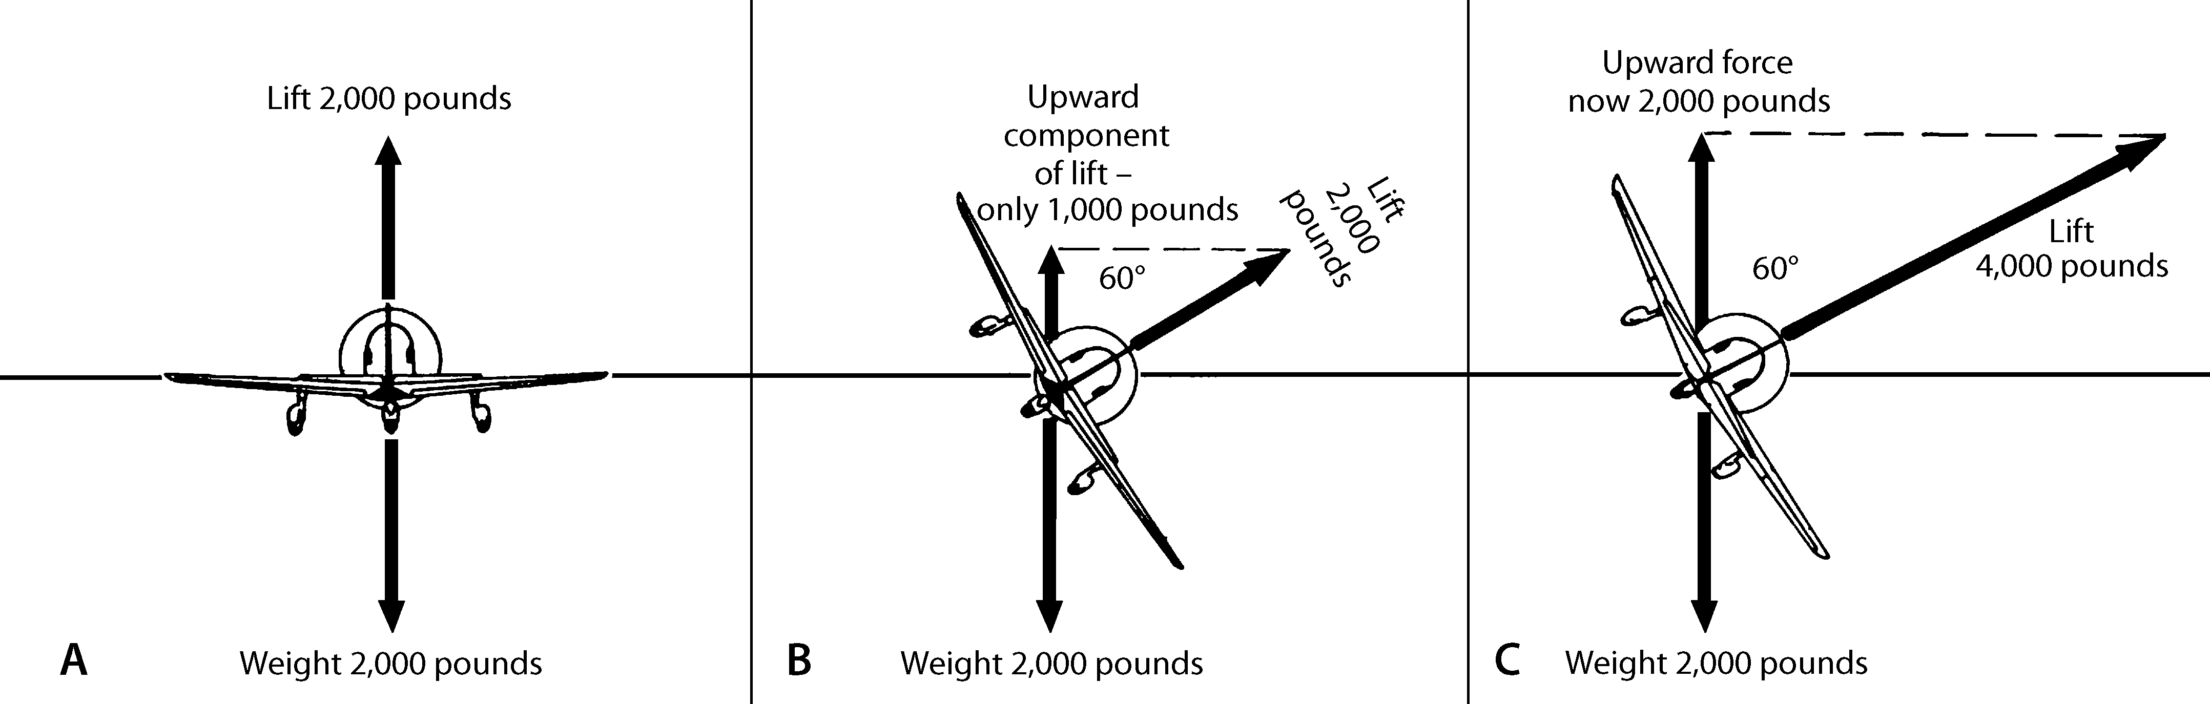
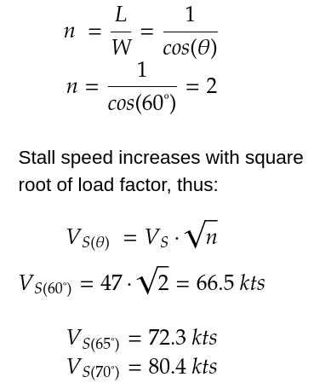
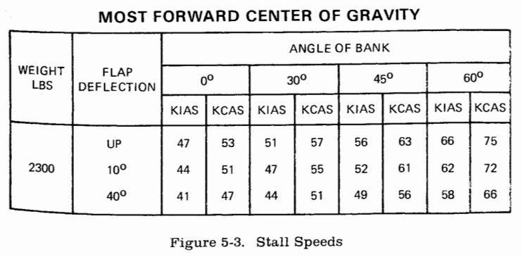
Engine failure after takeoff
Content:
How safe is flying
Statistics 2023
Eng failure after T/O
Midair collision
LOC in flight
Complacency
TEM
Three strikes rule
Other risks
Image: Learn to fly blog, https://learntoflyblog.com/aerodynamics-turns-and-load-factors/
Table: Cessna 172N POH, page 5-11

Slide 19
Engine failure after takeoff
Difference between training and real case
Human psychology – I know what to do but do I understand that this can really happen to me?
Engine after takeoff is the most critical emergency – low speed, low height, high angle of attack and runway just behind you (tempting?).
Be prepared.
Engine failure after takeoff checklist during engine warm up.
Content:
How safe is flying
Statistics 2023
Eng failure after T/O
Midair collision
LOC in flight
Complacency
TEM
Three strikes rule
Other risks

Slide 20
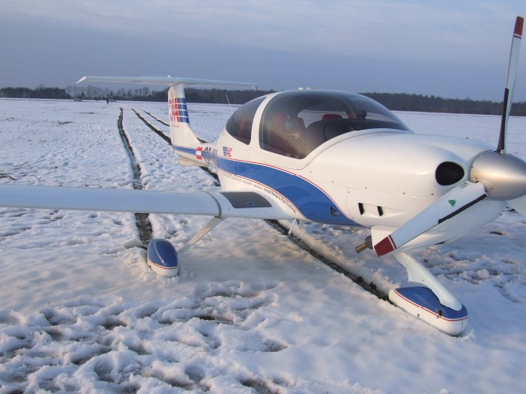
Engine failure after takeoff
Friday 1 March 2013
LJMB, Maribor, Slovenia
Diamond DA 40 D
Fatalities: 0 / Occupants: 2
Na letališču LJMB v fazi pristajanja s ponovnim vzletom (ang. Touch and Go) je prišlo do delne odpovedi delovanja motorja. Obrati motorja so se naglo zmanjšali prav v kritični fazi vzleta na višini 400 - 500 ft. nad terenom tako, da je letalo zgubljalo moč vzpenjanja.
Pilot se je takoj odločil pristati v smer leta na zasnežen teren brez ovir, približno 2 km južno od
VPS - vzletno pristajalne steze. Letalo in posadka nista utrpela nobenih poškodb.
Content:
How safe is flying
Statistics 2023
Eng failure after T/O
Midair collision
LOC in flight
Complacency
TEM
Three strikes rule
Other risks
Source: POVZETEK KONČNEGA POROČILA O INCIDENTU Številka: 37201-2/2012/20-00121019, Služba za preiskovanje letalskih nesreč in incidentov

Slide 21
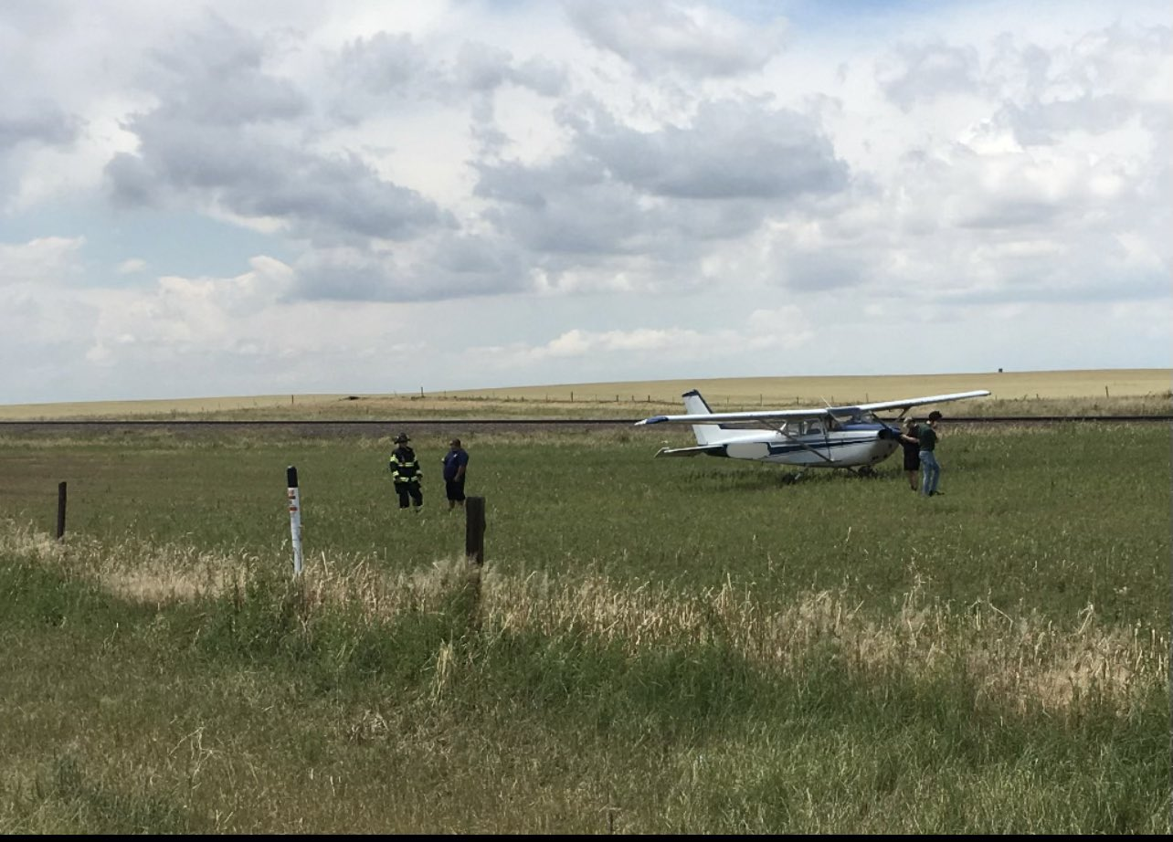
Engine failure after takeoff
Saturday 8 July 2023
KCFO - Denver, CO - USA
Cessna 172N Skyhawk II
Fatalities: 0 / Occupants: 2
The pilot and passenger were not injured.
According to the FAA, the airplane was practicing touch and goes when it experienced a loss of engine power shortly after takeoff, the airplane landed in a field, but struck powerlines during the process.
https://www.flightaware.com/live/flight/N739BE/history/20230708/1826Z/KCFO/L%2039.75617%20-104.49774
Content:
How safe is flying
Statistics 2023
Eng failure after T/O
Midair collision
LOC in flight
Complacency
TEM
Three strikes rule
Other risks
Photo: https://denvergazette.com/outtherecolorado/news/student-pilot-conducts-emergency-landing-after-plane-suddenly-loses-power-in-colorado/article_28c83fc2-1dcd-11ee-b016-ff06113867e4.html

Slide 22
Midair collision
Tuesday 7 March 2023
KGIF - Winter Haven, FL - USA
Piper J3C-65 Cub
Fatalities: 2 / Occupants: 2
Piper PA-28-161 Cadet
Fatalities: 2 / Occupants: 2
The flight instructor and pilot
receiving instruction on each
airplane were fatally injured.
The J3C was not equipped with a radio and was therefore not self-announcing or able to receive transmissions. A witness reported that J3C had approached from the north and had just turned in a westerly direction and appeared lower than the PA-28. The PA-28 pilot receiving instruction was performing power-off 180° landing maneuvers to runway 29 at the Winter Haven Regional Airport (GIF), Winter Haven, Florida. Four seconds after the PA-28 pilot announced a left turn to the base leg of the traffic pattern, the airplanes collided nearly straight on. The collision occurred about 575 ft mean sea level. Surveillance video footage showed no altitude or heading changes immediately before the collision.
Content:
How safe is flying
Statistics 2023
Eng failure after T/O
Midair collision
LOC in flight
Complacency
TEM
Three strikes rule
Other risks
Photo: https://www.clickorlando.com/news/local/2023/03/07/2-planes-collide-at-lake-hartridge-in-winter-haven-prompting-search/

Slide 23
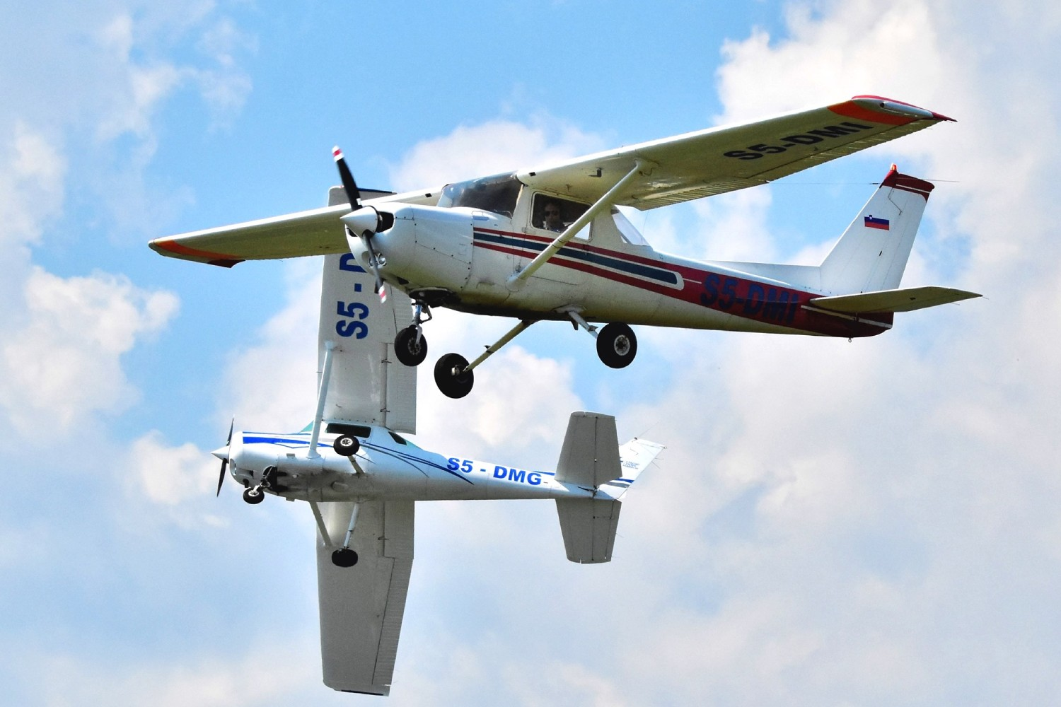
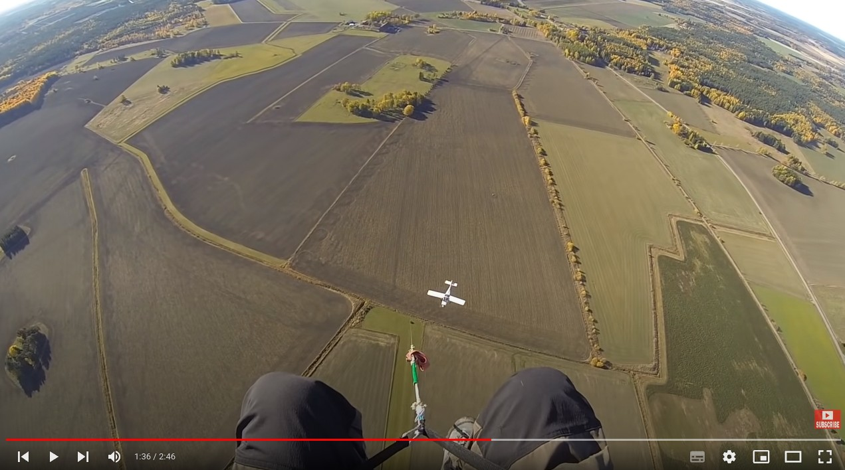
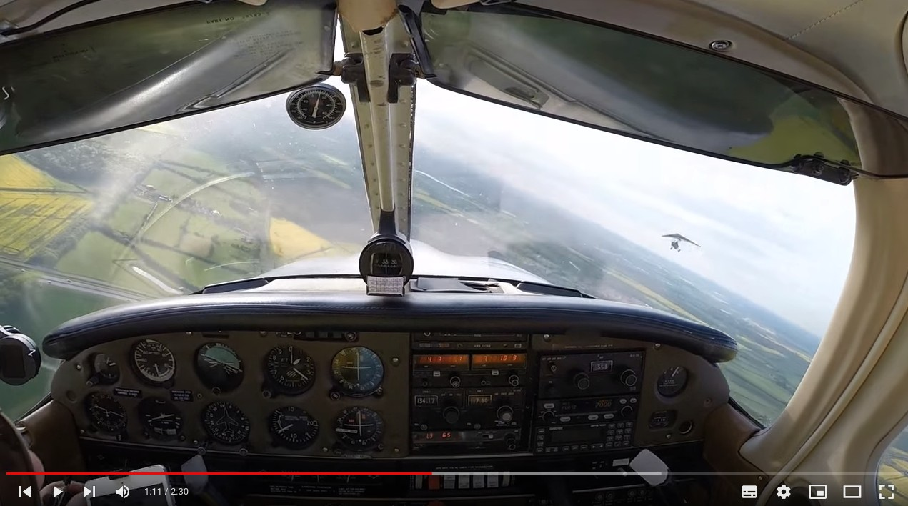
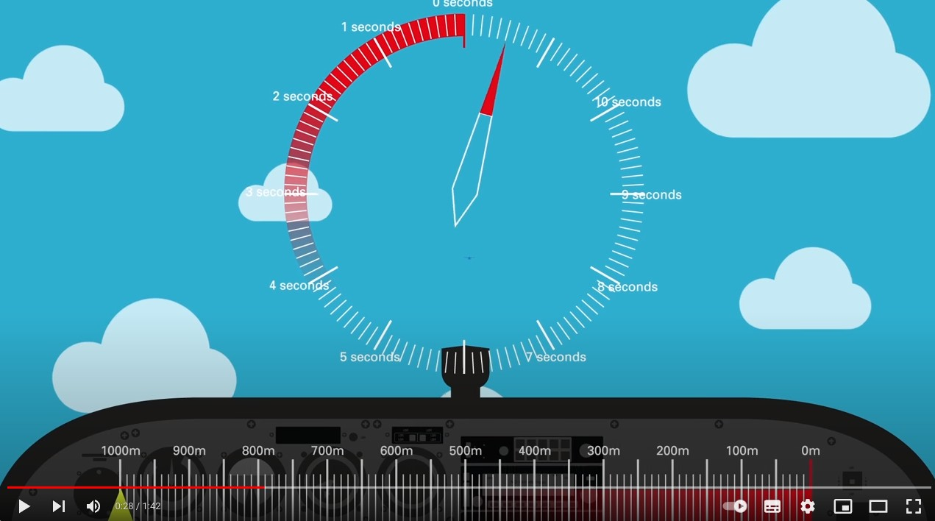
Midair collision
Mostly occur in traffic circuits in two scenarios:
1. Faster aircraft overruns slower
2. One on base, one on long final
If straight on – appears static until last 3-5 seconds
Danger of unusually wide traffic patterns
Content:
How safe is flying
Statistics 2023
Eng failure after T/O
Midair collision
LOC in flight
Complacency
TEM
Three strikes rule
Other risks
Photo: NHJOST, NHJ, Letalski center Maribor
https://www.youtube.com/watch?v=WI3Nq-fjkXI&t=90s
https://www.youtube.com/watch?v=H4TuJM3uuzY&t=65s
https://www.youtube.com/watch?v=20Qfi5BmDZM&t=27s

Slide 24
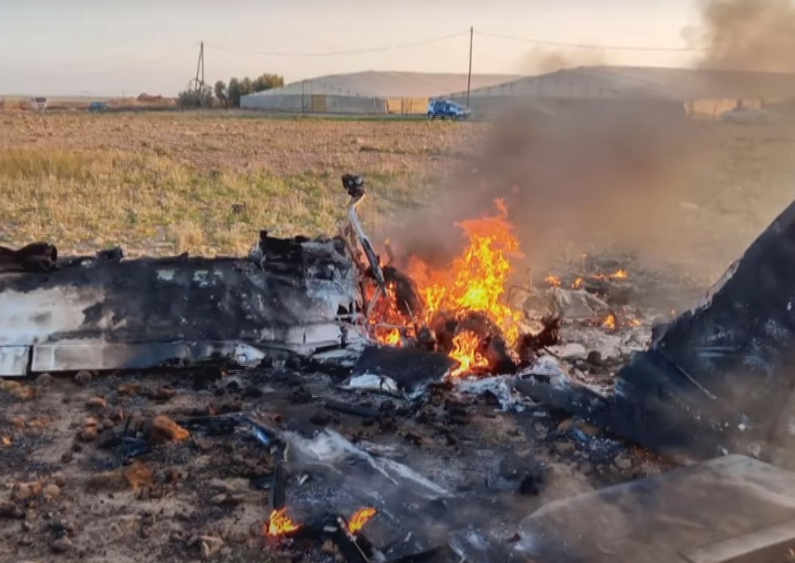
Loss of control in-flight
Thursday 5 January 2023
LELG - San Javier - Spain
Tecnam P2002 Sierra
Fatalities: 2 / Occupants: 2
Both pilots were killed and the aircraft was destroyed.
According to witness statements, after takeoff the aircraft made a 180º turn and made a pass over the runway in the opposite direction to takeoff. It then began a steep climb until it lost speed and began to fall with an almost vertical attitude, in a gentle turn, finally impacting the ground.
https://www.youtube.com/watch?v=Buu_Ke-1djc&t=1s
Content:
How safe is flying
Statistics 2023
Eng failure after T/O
Midair collision
LOC in flight
Complacency
TEM
Three strikes rule
Other risks
Photo: https://www.la7tv.es/video/sucesos/fallecidos-accidente-avioneta-san-javier-7/20230105205910008825.html

Slide 25
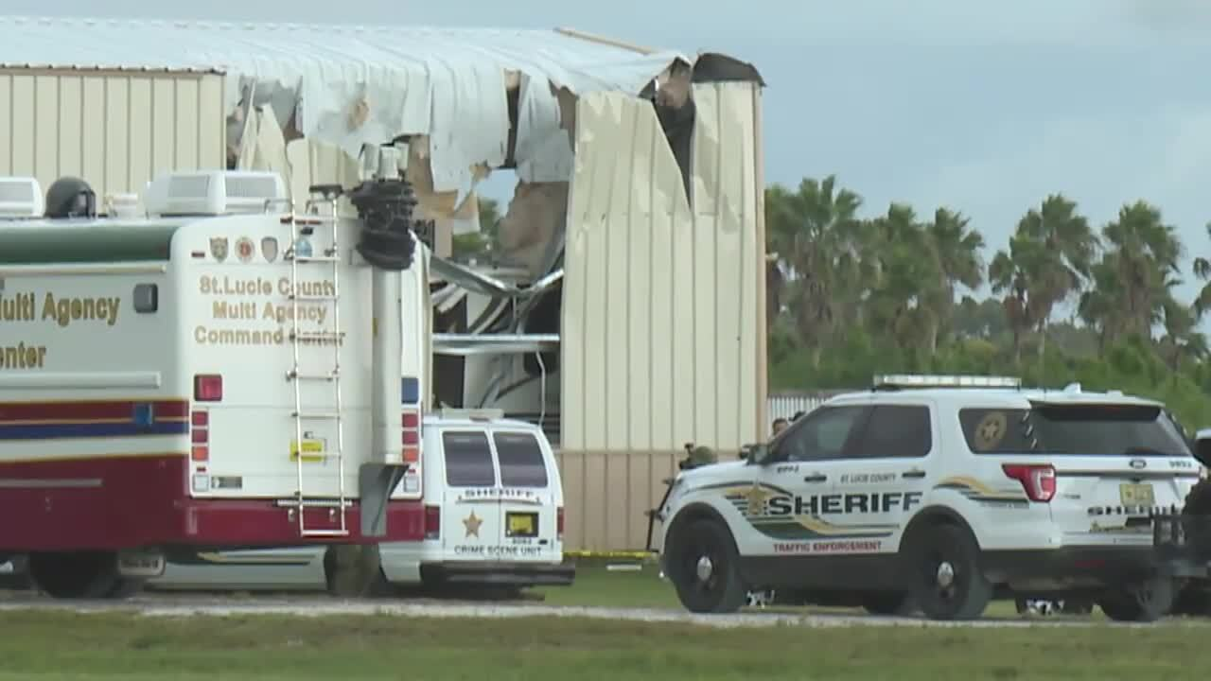
Loss of control in-flight
Thursday 17 August 2023
near Fort Pierce, FL - USA
Piper PA-28-161 Warrior III
Fatalities: 1 / Occupants: 2
One FI was fatally injured, the other FI sustained serious injuries.
According to the flight instructor seated in the left seat, the purpose of the flight was to conduct a proficiency check in order for the flight instructor seated in the right seat to begin instructing at the flight school. ... The left seat instructor reported that the right seat instructor satisfactorily demonstrated maneuvers... Subsequently, the right seat instructor asked him, “Can you show me something new?”
The left seat instructor responded that given he was already an instructor, there were no new maneuvers, but added, “I can show you an EASA maneuver.” He described that the maneuver involved a power-off aerodynamic stall and recovery without the use of engine power. The left seat instructor took the flight controls and initiated the demonstration; he pitched up and entered a full aerodynamic stall, with power at idle. After the airplane stalled, he recalled pitching to “Vg” (glide airspeed, 73 knots) to recover from the stall. During the recovery, with power at idle, he stated, “the right wing came off” and there was an “abrupt banking tendency” to the right.
Content:
How safe is flying
Statistics 2023
Eng failure after T/O
Midair collision
LOC in flight
Complacency
TEM
Three strikes rule
Other risks
Photo: https://www.wptv.com/news/treasure-coast/region-st-lucie-county/small-plane-crash-8-17-23

Slide 26
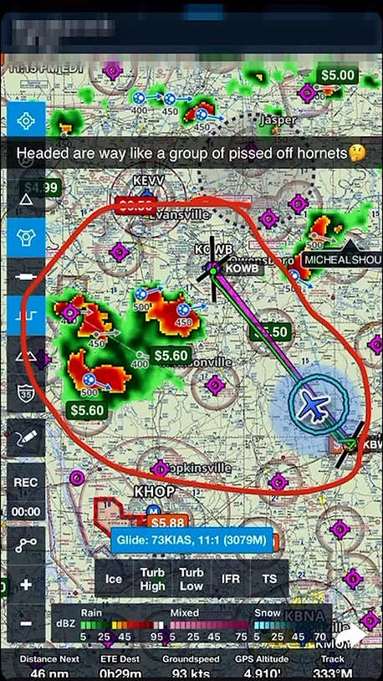
Loss of control in-flight, weather related
Wednesday 27 September 2023
near Whitesville, KY - USA
Piper PA-28-161 Warrior II
Fatalities: 2 / Occupants: 2
The flight instructor and student
pilot were fatally injured.
The pilot contacted ATC at 2244 and the controller advised the pilot of heavy to extreme precipitation at the airplane’s nine o’clock position. ADS-B data showed that the airplane continued its northwesterly course and about two minutes later, the flight instructor requested an instrument flight rules (IFR) clearance. The controller issued the clearance and provided an easterly vector to assist the flight in getting out of the weather. The flight instructor stated to the controller that the airplane was “getting blown around like crazy,” and the airplane’s flight track showed a turn to the northwest followed by a right circling turn. The controller reiterated the heading of 090º, and the flight instructor responded that they were in “pretty extreme turbulence.” The flight track showed a continuing right descending turn, and no further communications were received from the flight instructor.
Content:
How safe is flying
Statistics 2023
Eng failure after T/O
Midair collision
LOC in flight
Complacency
TEM
Three strikes rule
Other risks
Source: https://www.aviation101.com/deathbyflightinstructor, https://www.youtube.com/watch?v=vdvkR0o0VZA&t=171s

Slide 27
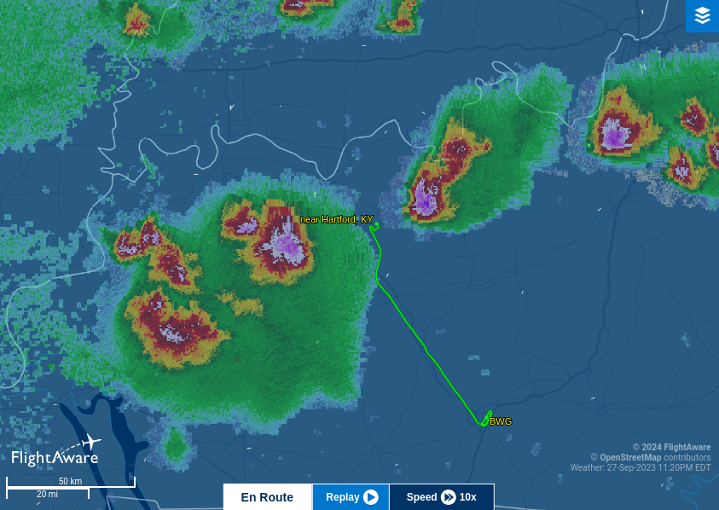
Loss of control in-flight, weather related
Content:
How safe is flying
Statistics 2023
Eng failure after T/O
Midair collision
LOC in flight
Complacency
TEM
Three strikes rule
Other risks
Source: https://www.flightaware.com/live/flight/N3079M

Slide 28
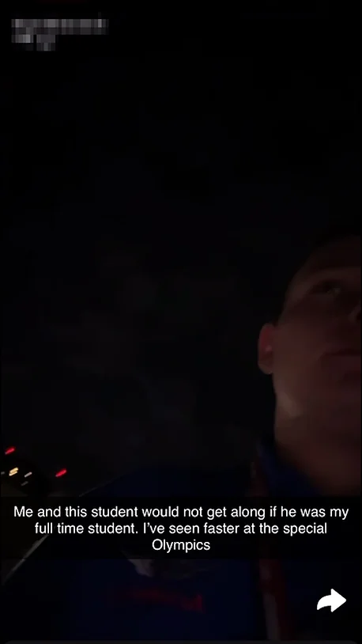
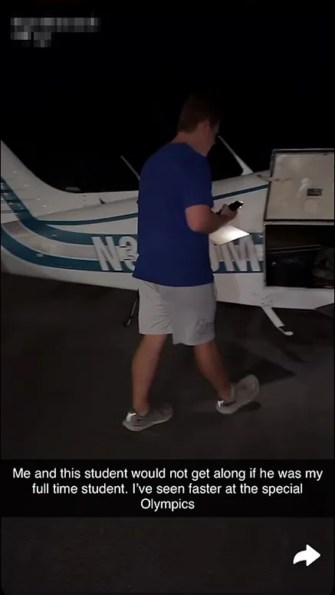
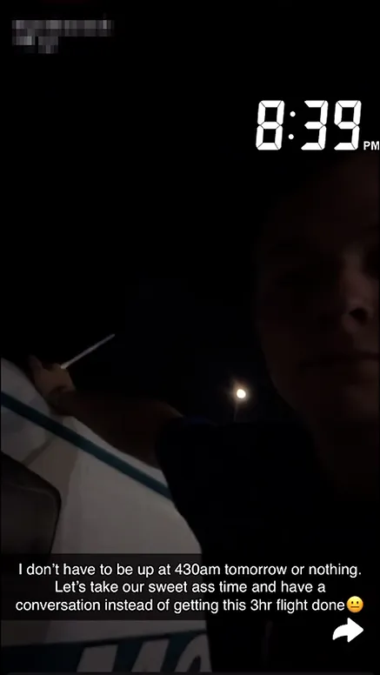
Loss of control in-flight, death by flight instructor
Content:
How safe is flying
Statistics 2023
Eng failure after T/O
Midair collision
LOC in flight
Complacency
TEM
Three strikes rule
Other risks
Source: https://www.aviation101.com/deathbyflightinstructor, https://www.youtube.com/watch?v=vdvkR0o0VZA&t=171s

Slide 29
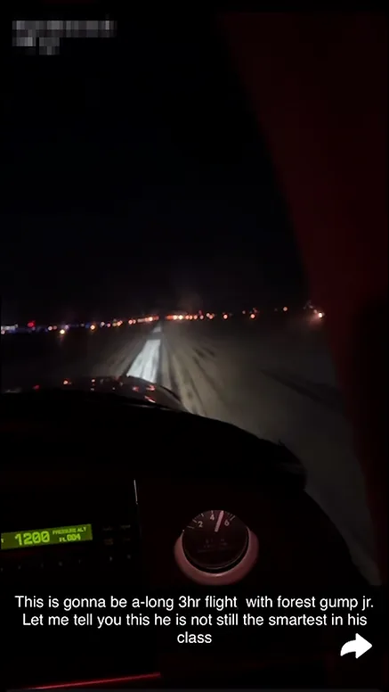
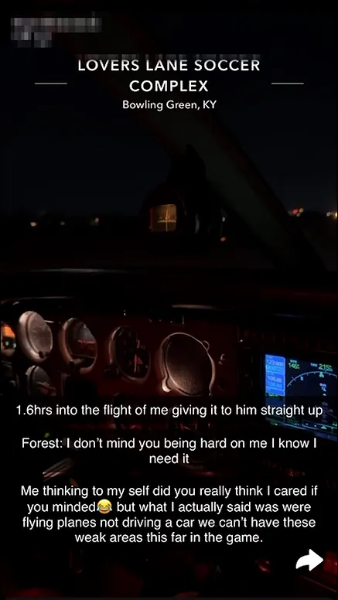
Loss of control in-flight, death by flight instructor
Content:
How safe is flying
Statistics 2023
Eng failure after T/O
Midair collision
LOC in flight
Complacency
TEM
Three strikes rule
Other risks
Source: https://www.aviation101.com/deathbyflightinstructor, https://www.youtube.com/watch?v=vdvkR0o0VZA&t=171s

Slide 30
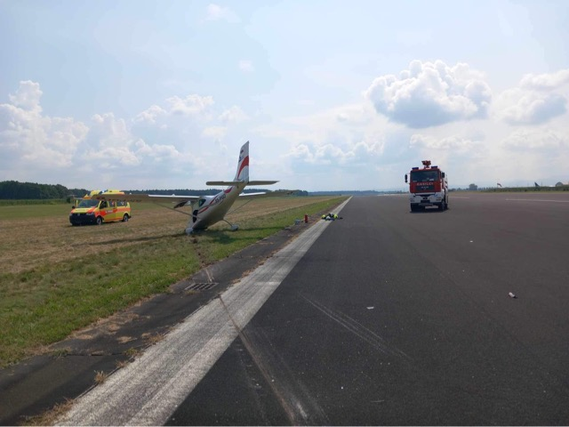
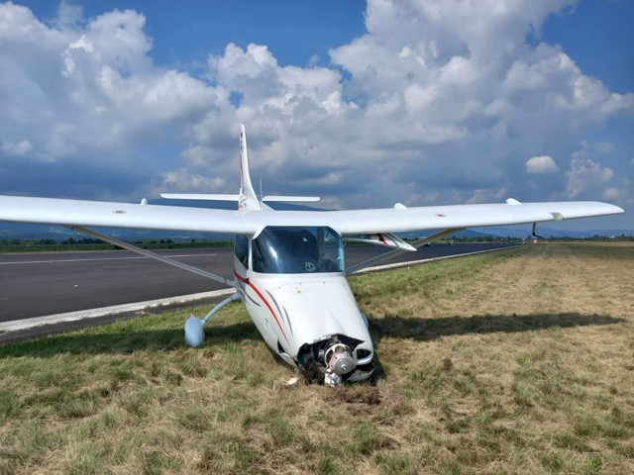
Bounced landing
Thursday 17 August 2023
LJMB, Maribor, Slovenia
Ob večji vertikalni hitrosti pri dotiku podvozja s pristajalno stezo je letalo odbilo v zrak, na kar je pilot odreagiral s spuščanjem nosnega dela navzdol proti VPS. Sledila sta še dva odboja od VPS, nakar je ob trdem pristanku prišlo do zloma nosne noge in posledično do trka propelerja ob asfaltni stezi. Letalo je zapeljalo levo s steze in pri tem z robom desnega krila podrsalo po stezi in nato po travi ob VPS, kjer se je približno 3 metre od roba VPS ustavilo.
TL Ultralight TL-3000 Sirius
Aircraft damage: Substantial
Content:
How safe is flying
Statistics 2023
Eng failure after T/O
Midair collision
LOC in flight
Complacency
TEM
Three strikes rule
Other risks
Source: OBVESTILO O ZAKLJUČKU PREISKAVE, 21.9.2023, Služba za preiskovanje letalskih, pomorskih in železniških nesreč in incidentov

Slide 31
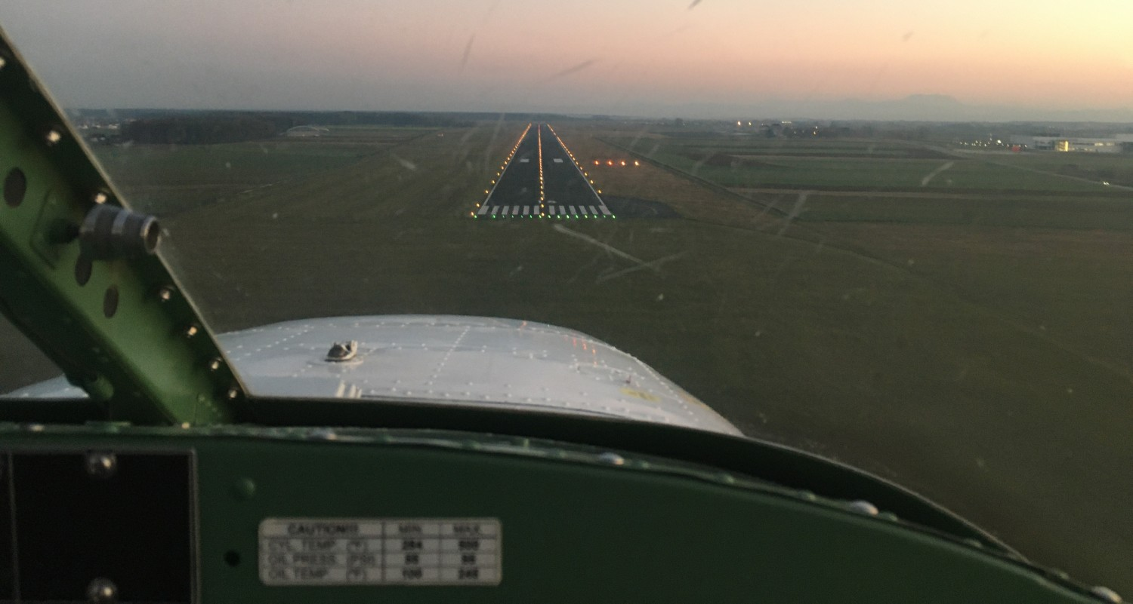
Bounced landing
Go-around from flare – are we training this?
Be prepared
Mindset on approach – we are making go-around, if nothings goes wrong then we land!
Content:
How safe is flying
Statistics 2023
Eng failure after T/O
Midair collision
LOC in flight
Complacency
TEM
Three strikes rule
Other risks

Slide 32
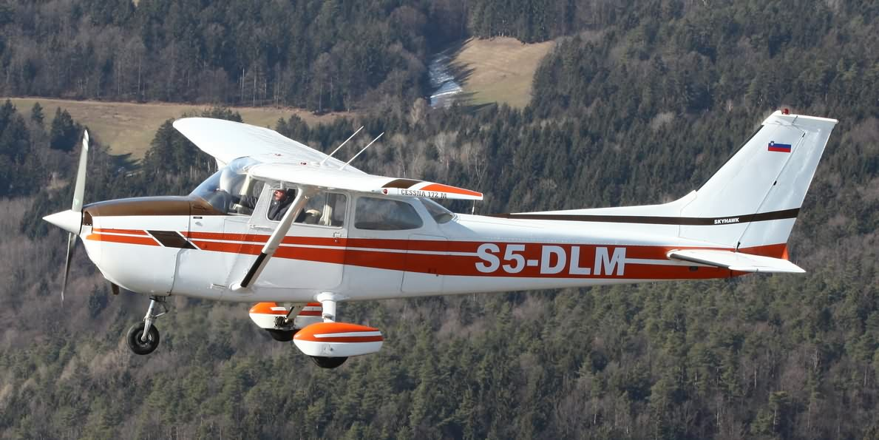
Hard landing (tailstrike)
Low approach / zone – low airspeed, low height, high AoA
Complacency?
Content:
How safe is flying
Statistics 2023
Eng failure after T/O
Midair collision
LOC in flight
Complacency
TEM
Three strikes rule
Other risks

Slide 33
Inadvertent complacency (nenamerno samozadovoljstvo)
A state of self-satisfaction with one's own performance coupled with an unawareness of danger, trouble, or controversy.^{[1]}
Routine activities (habitual, considered as easy and safe) - general relaxation of vigilance, important signals will be missed, only seeing what we expect to see.
Following a highly intense activity (recovering from a possible disaster) - the relief felt at the time can result in physical relaxation and reduced mental vigilance and awareness.
Too little stress results in under-stress, boredom, complacency and reduced human performance.
The Human Factors "Dirty Dozen"
The Dirty Dozen refers to twelve of the most common human error preconditions, or conditions that can act as precursors, to accidents or incidents.^{[2]}
Content:
How safe is flying
Statistics 2023
Eng failure after T/O
Midair collision
LOC in flight
Complacency
TEM
Three strikes rule
Other risks
Reference: 1. https://skybrary.aero/articles/complacency, 2. https://skybrary.aero/articles/human-factors-dirty-dozen

Slide 34
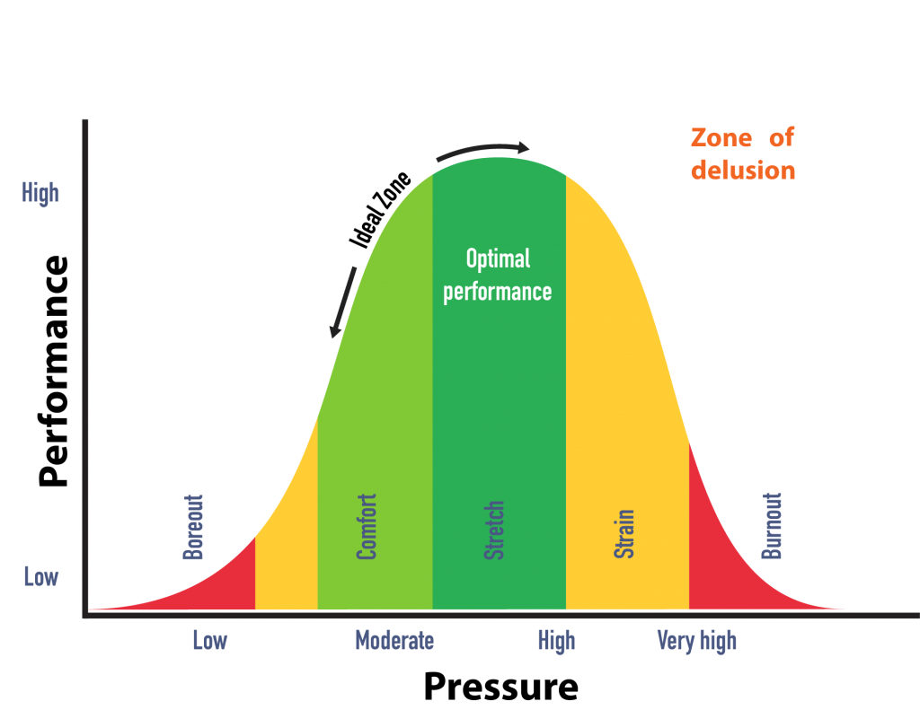
Inadvertent complacency - Countermeasures
When conducting simple, routine and habitual tasks, and when fatigued, to maintain an adequate, or optimum, level of stress through different stimulation.
Always expect to find a fault!
Following written instructions, and adhering to procedures that increase vigilance, such as inspection routines, can provide suitable stimulus.
Teamwork and mutual cross-checking will provide adequate stimulus when fatigued.
It is important to avoid:
working from memory – ignoring checklists!
assuming that something is ok when you haven’t checked it
signing off work that you are unsure has been completed.
Content:
How safe is flying
Statistics 2023
Eng failure after T/O
Midair collision
LOC in flight
Complacency
TEM
Three strikes rule
Other risks
Image credit: Delphis.org.uk

Slide 35
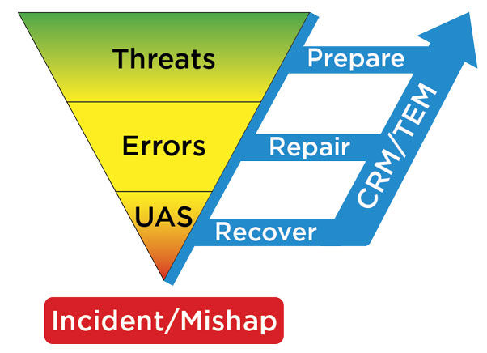
Threat and Error Management
Content:
How safe is flying
Statistics 2023
Eng failure after T/O
Midair collision
LOC in flight
Complacency
TEM
Three strikes rule
Other risks
Part of pilot training for all ICAO licenses.
Involves identifying, assessing, and mitigating potential threats and errors to enhance safety and prevent adverse events in flight operations.

Slide 36
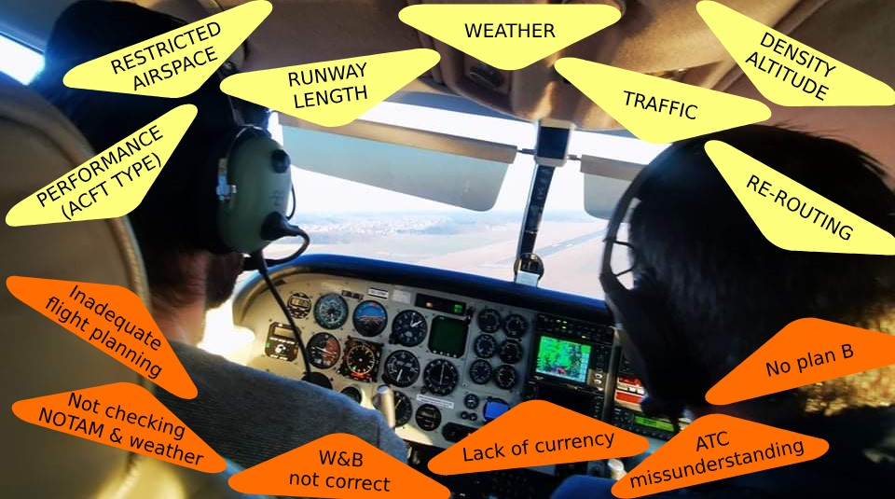
Threat and Error Management
Threats: come at the pilot
Errors: come from the pilot
…are everyday events that pilots must manage to maintain safety.
Content:
How safe is flying
Statistics 2023
Eng failure after T/O
Midair collision
LOC in flight
Complacency
TEM
Three strikes rule
Other risks

Slide 37
Threat and Error Management
Threats
Events or things that occur outside our control which require your attention if safety is to be maintained.
Mitigate the situation.
Errors
Actions or inactions that lead to unwanted or unsafe deviation from the plan.
Avoid making one or more errors.
Trap to prevent the situation getting worse.
Mitigate the outcome.
Content:
How safe is flying
Statistics 2023
Eng failure after T/O
Midair collision
LOC in flight
Complacency
TEM
Three strikes rule
Other risks

Slide 38
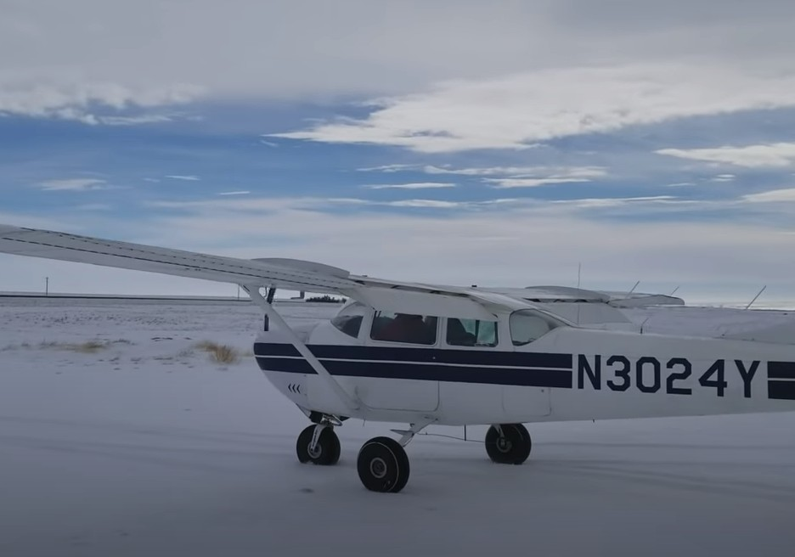
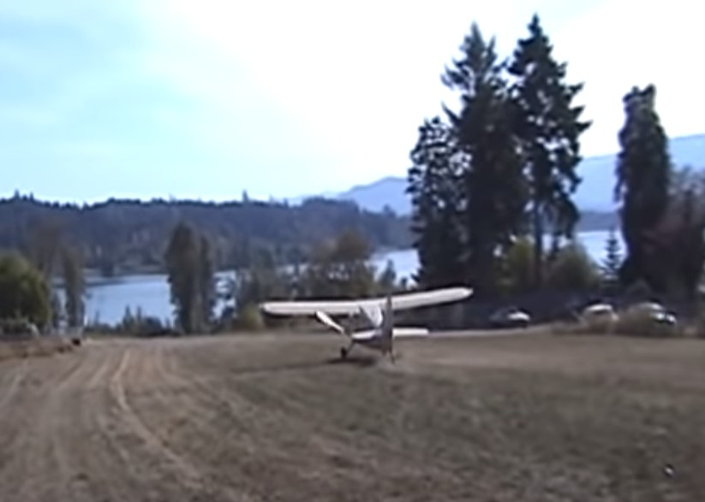
Threat and Error Management
Pre-flight TEM:
What are the Threats to flight safety?
What are the Errors to watch out for?
How am I going to manage them?
In-flight TEM:
Same questions!
Post-flight TEM:
Was my management effective?
What threats were presented?
How did I mitigate them?
What errors did I make?
Did I avoid making one or more errors?
Did I trap any to prevent the situation getting worse?
Did I mitigate what they left me with?
Content:
How safe is flying
Statistics 2023
Eng failure after T/O
Midair collision
LOC in flight
Complacency
TEM
Three strikes rule
Other risks
https://www.youtube.com/watch?v=zymRQU63EtI&t=154s
https://www.youtube.com/watch?v=6BoKzLw-dzU

Slide 39
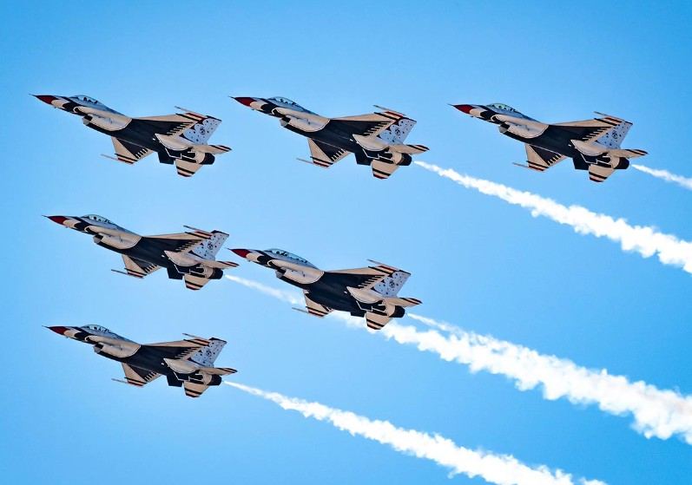
Three strikes rule
After committing 3 mental errors which by themselves are not big safety concern but cumulatively indicate we’re not mentally fit for safe flying – terminate flight.
Exp. mental errors:
forget a step in preflight inspection,
missunderstand taxi instruction,
forget cabin door or seat belt,
calling ATC on wrong frequency,
Etc…
After strike #2 pilot normally sharpens up to avoid #3.
Extend the rule to 3 threats (marginal
Weather, low recent experience on type,
werformance, night…)
Don’t fly if 3 threats.
Content:
How safe is flying
Statistics 2023
Eng failure after T/O
Midair collision
LOC in flight
Complacency
TEM
Three strikes rule
Other risks
Photo credit: US Airforce, www.airforce.com

Slide 40
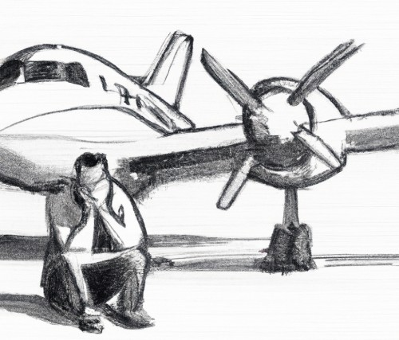
Other risks at training
FI’s fatigue, lack of concentration, rush
FIs in aeroclubs are volunteers, performing training operations before/between/after primary jobs.
Content:
How safe is flying
Statistics 2023
Eng failure after T/O
Midair collision
LOC in flight
Complacency
TEM
Three strikes rule
Other risks
Countermeasures:
FIs are informed of the hazard and the need of adequate rest, hydration and to plan activities with enough time margin.
Strict use of checklists for all training operations and implementation of new checklists for gliders.

Slide 41
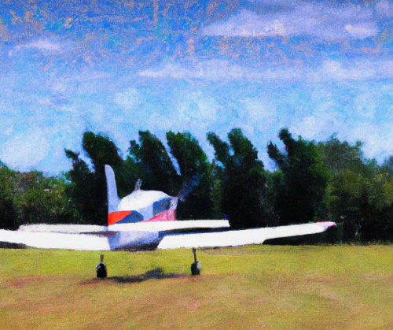
Other risks at training
Use of unsuitable runways
Besides LJMB, operations are being performed on surrounding grass airfields. Especially during spring months the surface conditions can be unpredictable.
Content:
How safe is flying
Statistics 2023
Eng failure after T/O
Midair collision
LOC in flight
Complacency
TEM
Three strikes rule
Other risks
Countermeasures:
FIs have to acquire the runway conditions by getting in contact with given airfield operators or by any other adequate means. In case of insufficient information is being held, operations on such airfields are to be avoided.

Slide 42
Other risks at training
Birdstrikes
07.08.2021 C152 S5-DMI Birdstrike
23.09.2021 C152 S5-DMI Birdstrike – ATO operation
26.06.2022 PA18 S5-DBV Birdstrike during aerotow
05.07.2023 C152 S5-DMG Birdstrike – ATO operation
15.08.2023 AC11 S5-DRM Birdstrike
25.09.2023 C152 S5-DMG Birdstrike causing damage to cowling – ATO operation
Content:
How safe is flying
Statistics 2023
Eng failure after T/O
Midair collision
LOC in flight
Complacency
TEM
Three strikes rule
Other risks

Slide 43
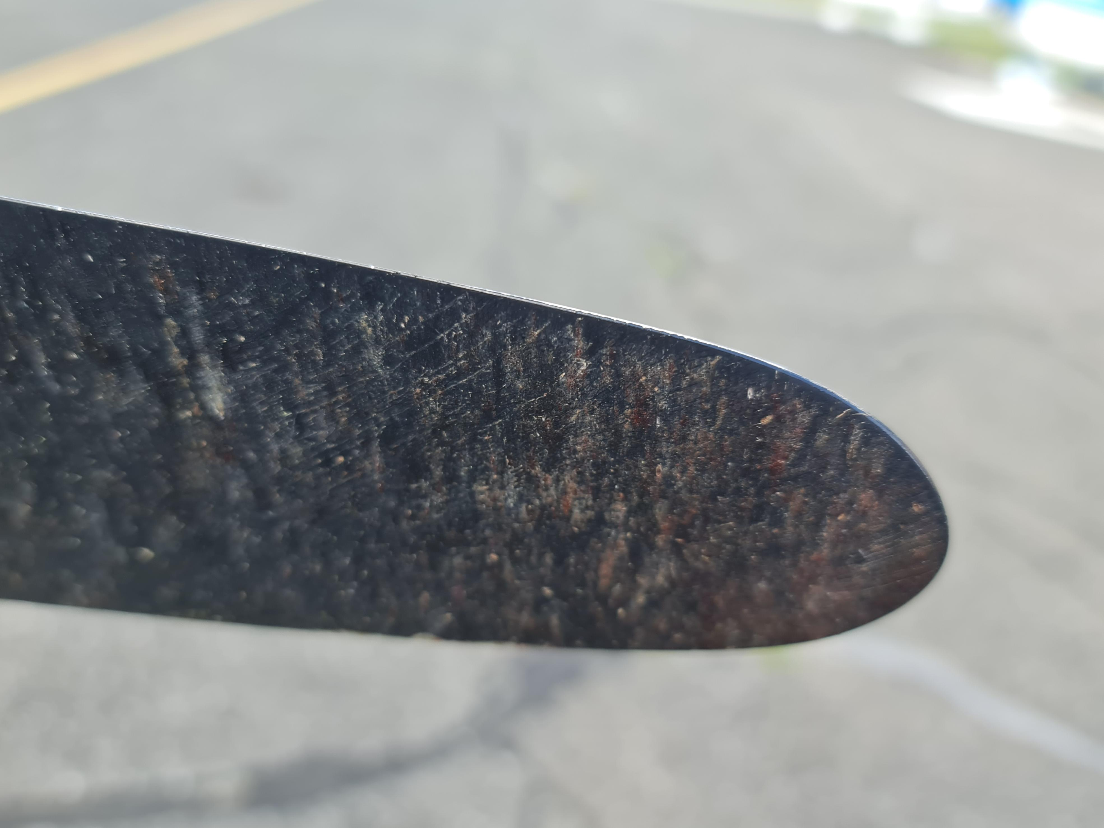
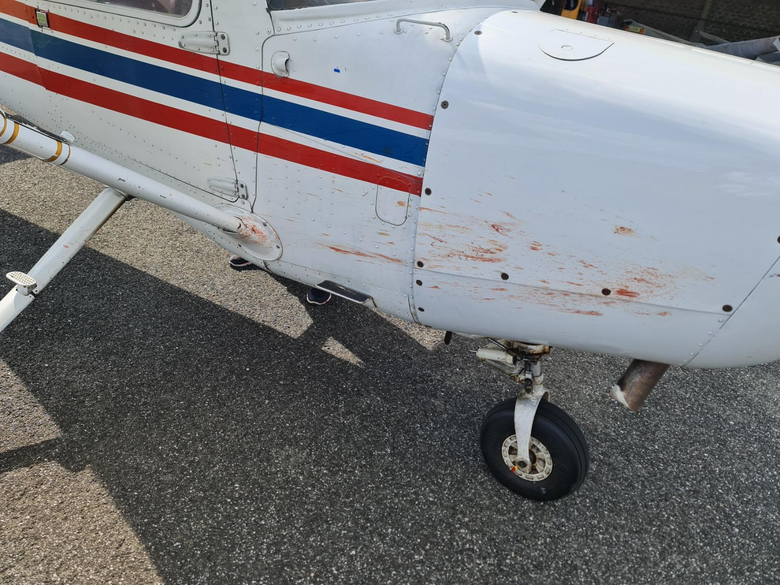
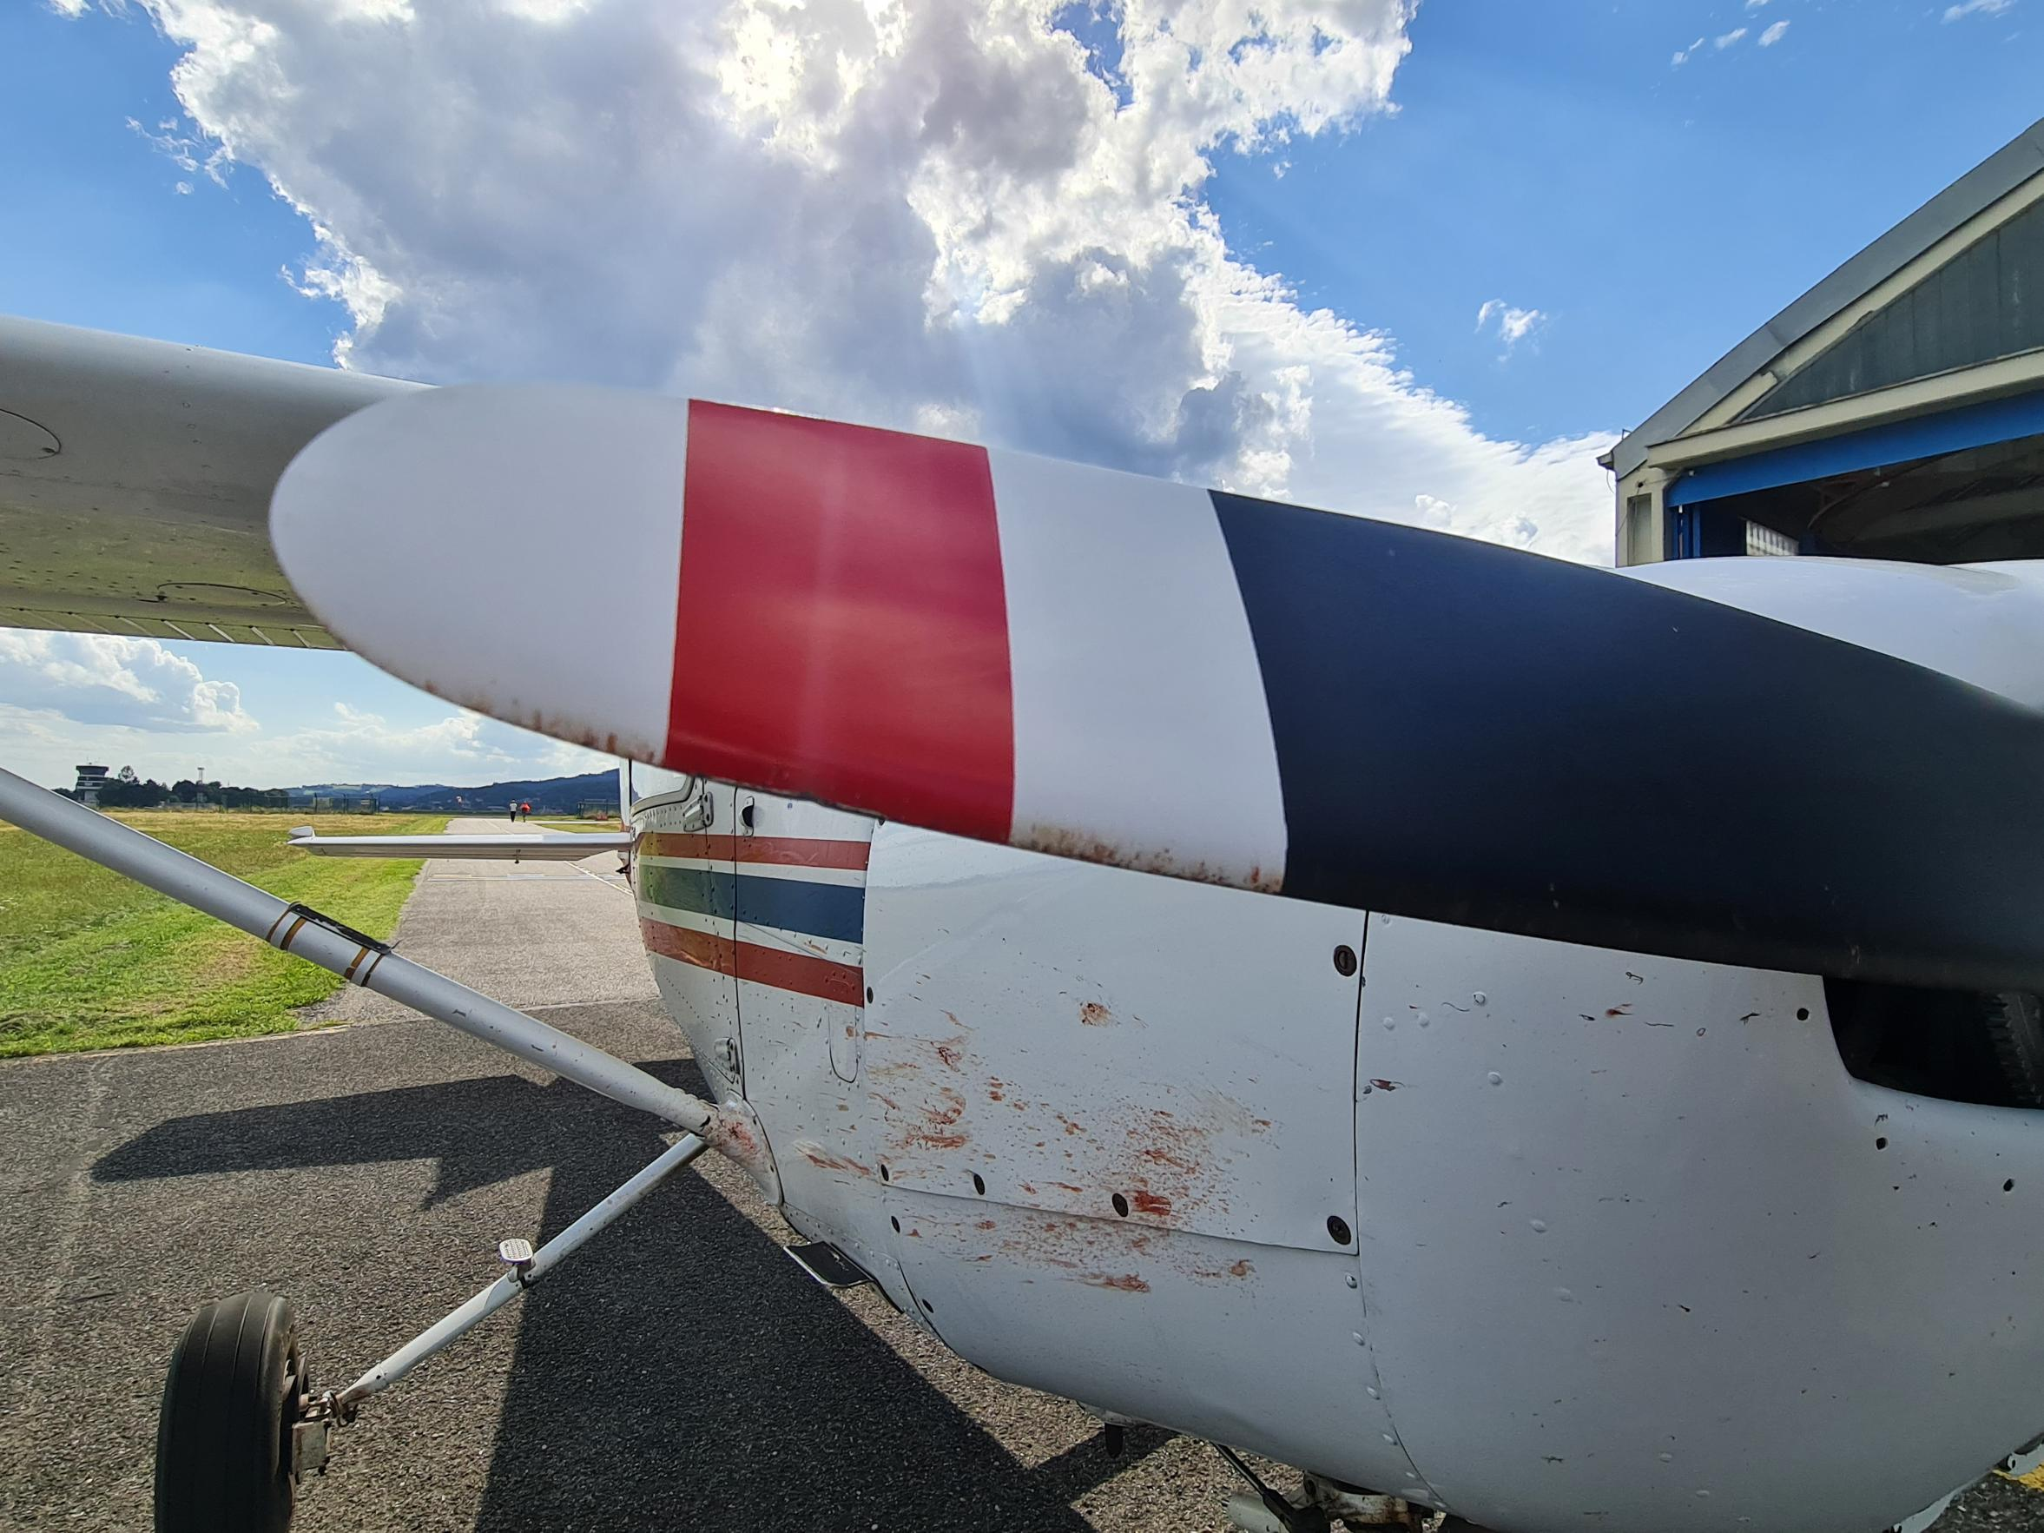
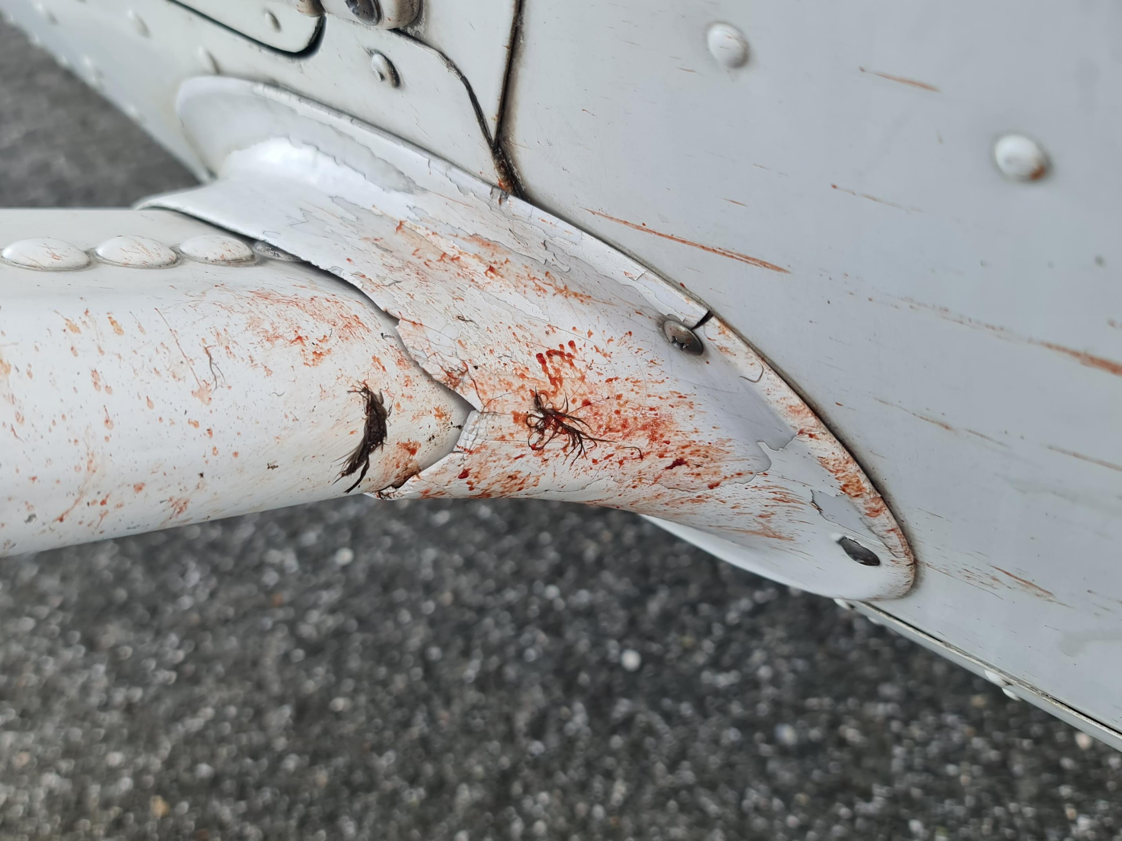
Content:
How safe is flying
Statistics 2023
Eng failure after T/O
Midair collision
LOC in flight
Complacency
TEM
Three strikes rule
Other risks

Slide 44
Content:
How safe is flying
Statistics 2023
Eng failure after T/O
Midair collision
LOC in flight
Complacency
TEM
Three strikes rule
Other risks

Slide 45
Other risks at training
Laser attack
https://www.youtube.com/watch?v=QqcoQk6sO8A
Content:
How safe is flying
Statistics 2023
Eng failure after T/O
Midair collision
LOC in flight
Complacency
TEM
Three strikes rule
Other risks

